Slide 1

White Box TESTING

Slide 2
White-Box Testing:-
White Box Testing is software testing technique in which internal structure, design and coding of software are tested to verify flow of input-output and to improve design, usability and security. In white box testing, code is visible to testers so it is also called Clear box testing, Open box testing, Transparent box testing, Code-based testing and Glass box testing.

Slide 3
->Control flow testing:
Control flow testing is a type of software testing that uses program’s control flow as a model. Control flow testing is a structural testing strategy. This testing technique comes under white box testing. For the type of control flow testing, all the structure, design, code and implementation of the software should be known to the testing team.
->Data flow testing:
Data flow testing is a family of test strategies based on selecting paths through the program's control flow in order to explore sequences of events related to the status of variables or data objects. Dataflow Testing focuses on the points at which variables receive values and the points at which these values are used.

Slide 4
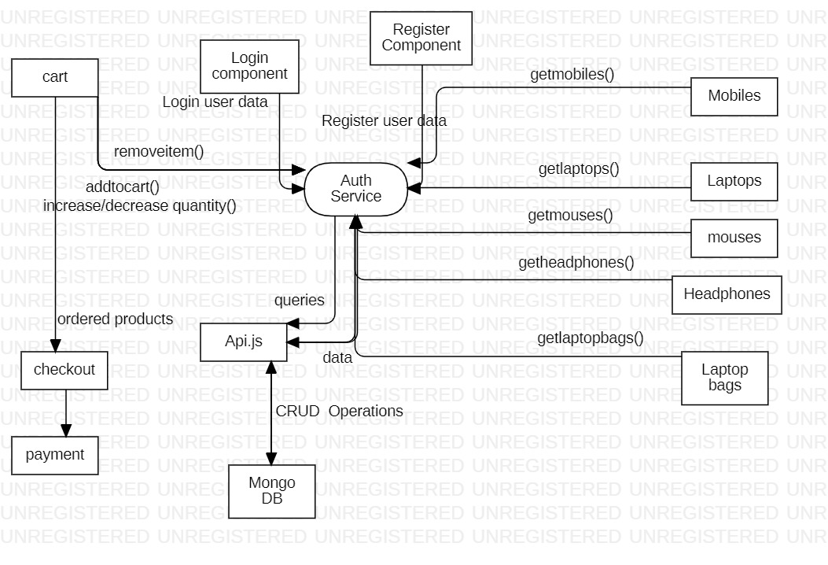
Control And Data-Flow:

Slide 5
Procedure:-
1.Initially, the requirements and specifications of the system are examined.
2.Tester chooses valid inputs (positive test scenario) to check whether SUT processes them correctly. Also, some invalid inputs (negative test scenario) are chosen to verify that the SUT is able to detect them.
3.Tester determines expected outputs for all those inputs.
4.Software tester constructs test cases with the selected inputs.
5.The test cases are executed.
6.Software tester compares the actual outputs with the expected outputs.
7.Defects if any are fixed and re-tested.

Slide 6
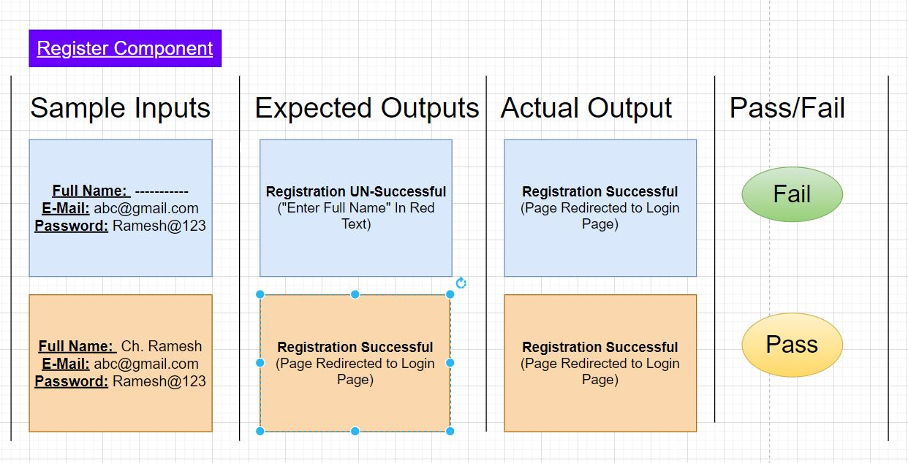

Slide 7
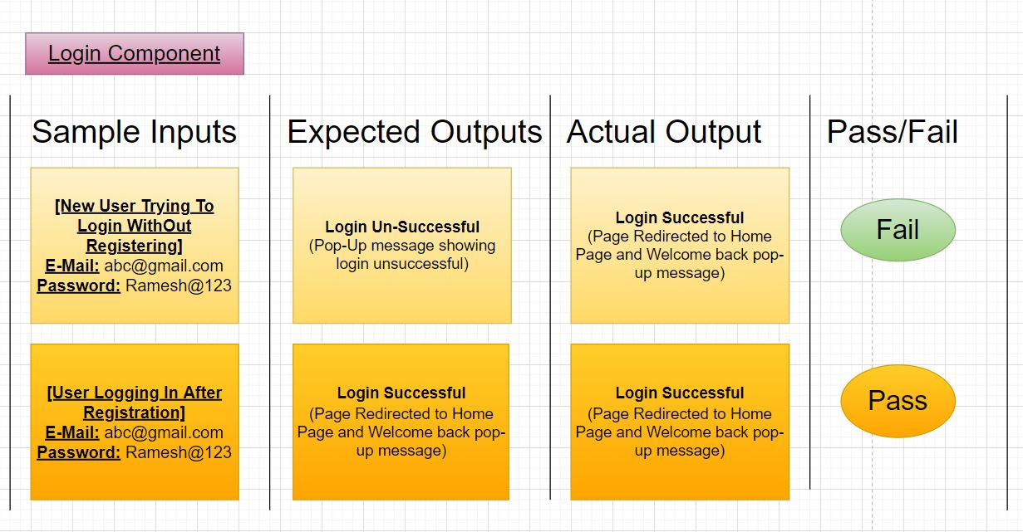

Slide 8
